Slide 1

Motor Insurance Pure Premium Prediction
An Interpretable Neural Additive Model Based on Multi-Task Learning
Undergraduate Thesis Defense
Presenter: Ruize Jin
Major: Actuarial Science
Student ID: 2022310768
Supervisor: Liu Jian
School: School of Insurance
Date: May 8, 2026
Notes:
Good afternoon, members of the committee. I am Ruize Jin, an undergraduate student in Actuarial Science at the School of Insurance. My thesis is titled “Motor Insurance Pure Premium Prediction — An Interpretable Neural Additive Model Based on Multi-Task Learning.” Today I will present the research background, methodology, key findings, and conclusions. The study addresses a central challenge in motor insurance pricing: improving predictive performance without sacrificing model interpretability, with the goal of providing a more practical modeling approach for the industry.

Slide 2
CONTENTS
CONTENTS
Research Background and Significance
Research Design and Model Development
01
02
Industry context, problem statement, research objectives, and significance
Research framework, model specification, benchmark models, data sources, and evaluation metrics
Experimental Results and Analysis
Conclusions, Limitations, and Future Work
03
04
Exploratory data analysis, multidimensional performance comparison, and model interpretability
Summary of key findings, contributions, limitations, and future research directions
0
Notes:
Today I will present the study in four parts: research background and significance; research design and model development; experimental results and interpretability analysis; and conclusions, limitations, and future work.

Slide 3

01
Research Background and Significance
RESEARCH BACKGROUND AND SIGNIFICANCE

Slide 4
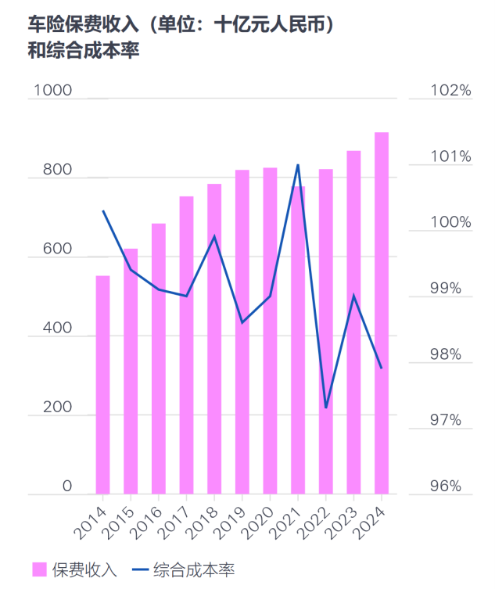



Industry Background: Scale and Challenges
Large Market Scale
Motor insurance premiums exceeded RMB 913 billion in 2024, accounting for over 54% of total non-life premiums; vehicle ownership reached 353 million, and the market continues to expand.
Underwriting Profitability Challenge
The industry combined ratio has long fluctuated around break-even, leaving underwriting profitability fragile. Accurate pricing is a key lever for improving underwriting margins.
Core Industry Challenge
How can data and analytics enable sound, granular, and accurate pricing in an intensely competitive market?
Notes:
I will begin with the research background. Motor insurance is one of the largest lines in China’s non-life insurance market, and pure premium prediction directly affects ratemaking, risk segmentation, and underwriting profitability.

Slide 5




Problem Statement: The Accuracy–Interpretability Trade-off
Traditional Actuarial Models (e.g., GLM)
Strength: transparent structure and strong interpretability, well suited to regulatory and audit requirements.
Limitation: linear assumptions restrict complex nonlinear risk relationships and can limit predictive accuracy.
Modern Machine-Learning Models (e.g., GBM)
Strength: powerful nonlinear modeling capacity that can extract complex structure and improve risk prediction.
Core Tension: Trade-off and Balance
Limitation: black-box decision logic is difficult to interpret directly and harder to audit.
How can we move beyond the apparent conflict between predictive accuracy and interpretability? This is the central question of the study.
Notes:
When choosing pricing models, traditional statistical models are generally robust and interpretable, but can be limited in their ability to represent nonlinear relationships, zero inflation, and heavy-tailed data. Machine-learning and deep-learning models can be more predictive, but often behave as black boxes and may not satisfy the transparency and auditability requirements of actuarial pricing.

Slide 6





Research Objectives and Significance
Research Objectives
Research Significance
01. Build a Multi-Task Neural Additive Model (MTL-NAM)
Methodological Contribution
Jointly predict claim frequency and severity in a unified framework and leverage shared information across tasks.
Explore the integration of multi-task learning and structurally interpretable models in actuarial pricing, offering a new perspective on the performance–interpretability trade-off.
02. Balance Predictive Accuracy and Interpretability
Improve pure premium prediction while preserving inherent interpretability rather than relying on a black box.
Practical Value for Insurance Risk Management
Provide a reproducible modeling approach that supports more accurate and transparent pricing and more granular risk management.
03. Systematic Evaluation on Real-World Data
Use the freMTPL motor insurance dataset for controlled benchmark experiments evaluating both effectiveness and interpretability.
Notes:
The central research question is therefore: how can we improve motor insurance pure premium prediction while preserving as much model interpretability as possible?

Slide 7

02
Research Design and Model Development
RESEARCH DESIGN AND MODEL CONSTRUCTION
Project code on GitHub: https://github.com/KimJerry114514/Pure-Premium-Prediction-with-Multi-Learning-Neural-Additive-Model

Slide 8

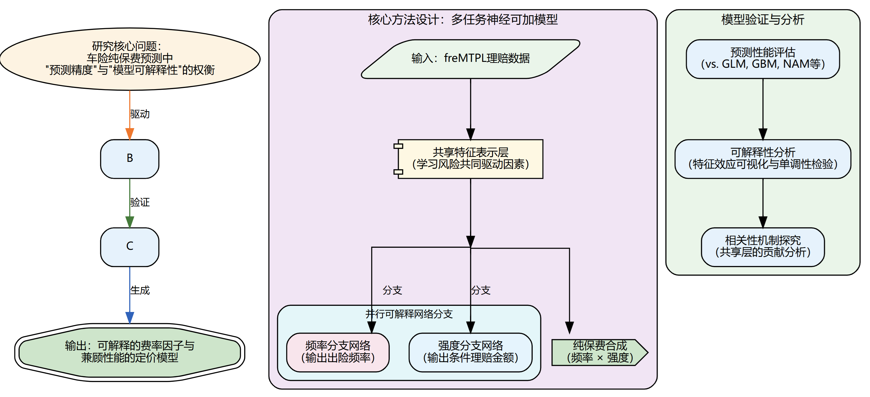



Research Framework and Technical Workflow
01 / Problem Identification
▍ Research Logic
Identify the central tension between predictive accuracy and interpretability in motor insurance pricing.
02 / Method Development
Apply MTL-NAM to pure premium modeling and jointly learn claim frequency and severity.
03 / Empirical Validation
Using freMTPL and six-fold cross-validation, compare MTL-NAM out of sample with GLM, GBM, and NAM using NLL, RMSE, and MAE, together with shape functions and SHAP for interpretability.
A closed-loop workflow: problem → method → validation → application
04 / Implications
Assess whether MTL-NAM can combine strong predictive performance with interpretability and provide practical evidence for granular motor insurance pricing.
Notes:
The study uses experimental and comparative research methods. Claim frequency and claim severity are treated as two related tasks in an MTL-NAM. The empirical analysis uses the French motor third-party liability dataset distributed in R and constructs policy-level observations for model training and evaluation. GLM, GBM, and single-task NAM are used as benchmarks. Six-fold cross-validation provides out-of-sample comparisons, and NLL, RMSE, and MAE evaluate distributional fit and point-prediction error. Shape functions and SHAP are then used to examine interpretability.

Slide 9
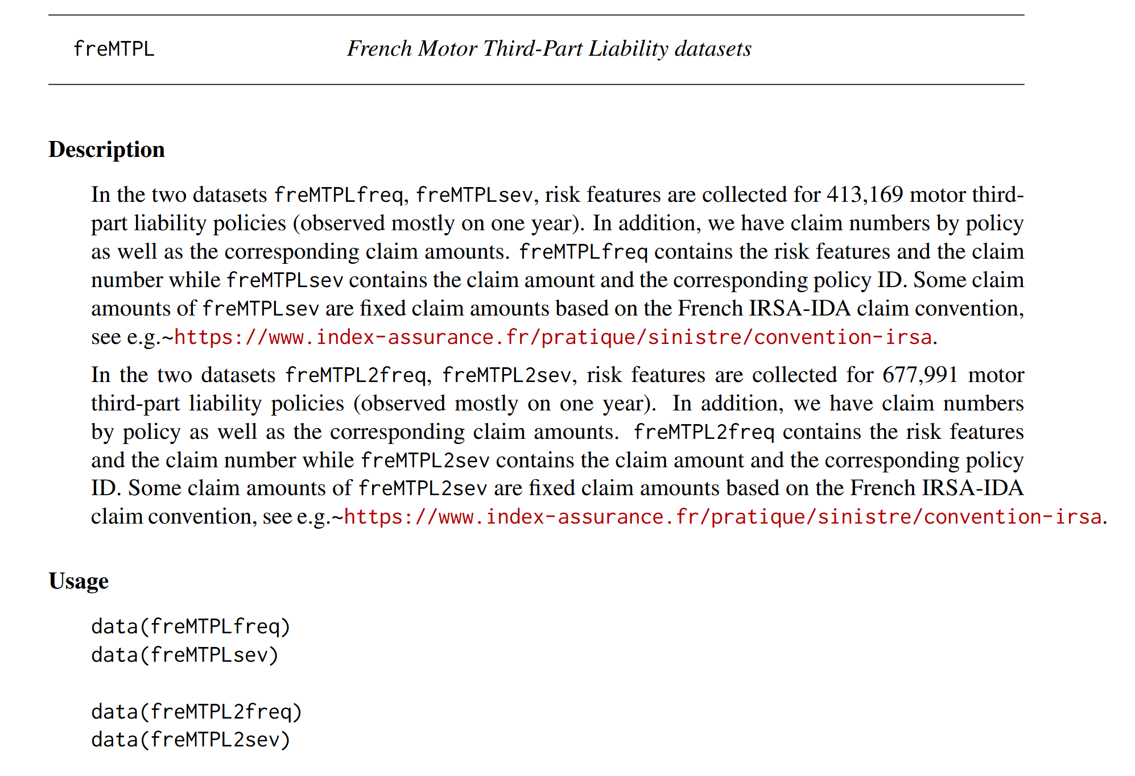
freMTPL French Motor Third-Party Liability Dataset
Variable | Type / Values | Description
IDpol | Integer ID | Policy ID
ClaimNb | Non-negative integer | Claims during observation period
Exposure | Continuous in [0, 1] | Exposure (years)
VehPower | Ordered discrete; mapped as categorical | Vehicle power
VehAge | Continuous (years) | Vehicle age
DrivAge | Continuous (years) | Driver age
BonusMalus | Continuous (50–350) <100 = bonus, >100 = malus | Bonus–Malus coefficient
VehBrand | Categorical | Vehicle brand
VehGas | Categorical (Diesel / Regular) | Fuel type
Area | Categories A–F | Residential density class
Density | Continuous; persons/km² | Population density
Region | Categorical | French region
Variables in freMTPL2freq
freMTPL is widely used in actuarial and machine-learning research. It contains policy characteristics and claim records, is publicly accessible, and is anonymized for research use.
Variable | Type / Values | Description
IDpol | Integer ID | Policy ID
ClaimAmount | Continuous (amount) | Individual claim amount
Variables in freMTPL2sev

Slide 10
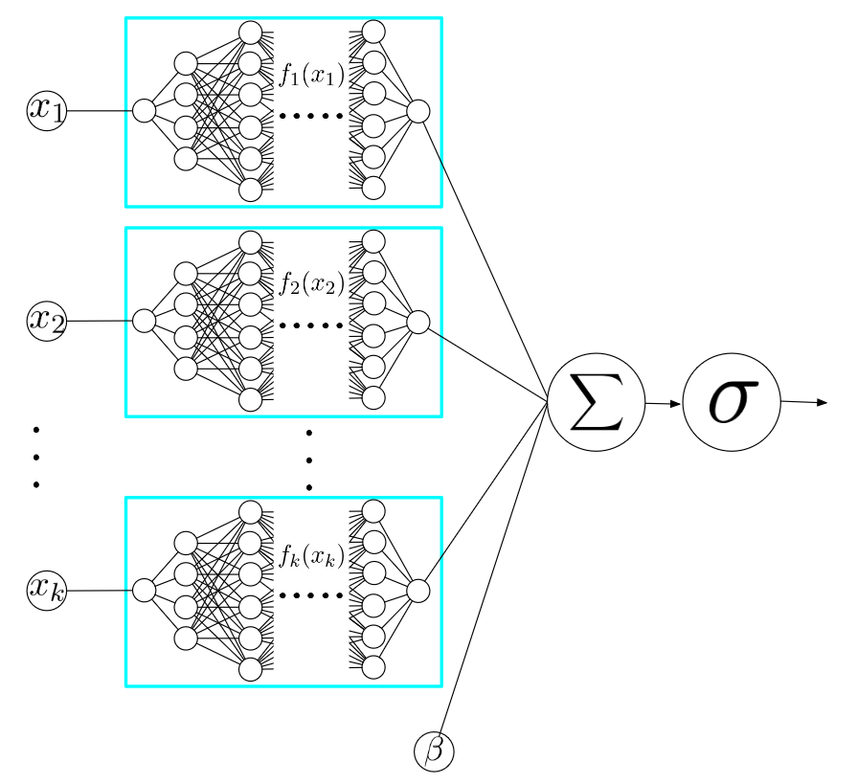
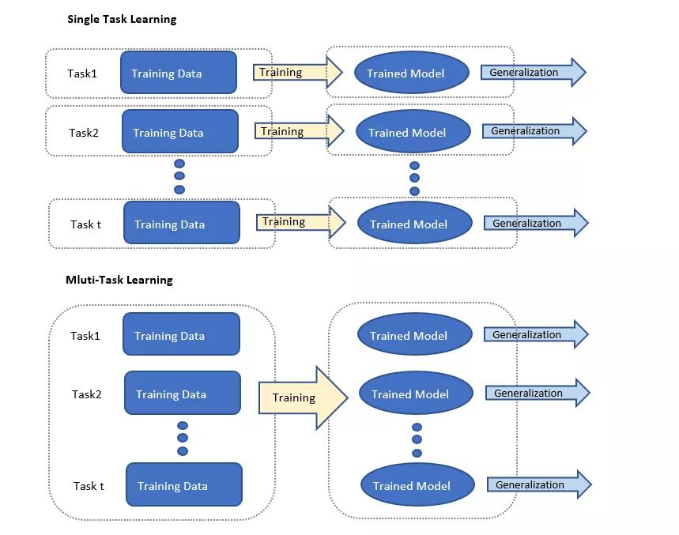
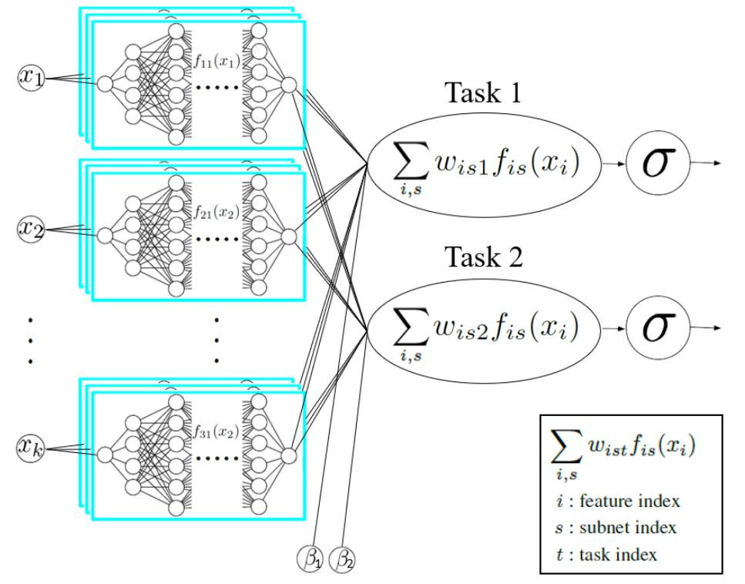
Theoretical Foundations: Neural Additive Models (NAMs) and Multi-Task Learning (MTL)
Neural Additive Model
Multi-Task Learning
Multi-Task Neural Additive Model
▍ Core Idea
Retain an interpretable additive structure while replacing linear terms with neural subnetworks that learn nonlinear marginal feature effects.
Train related tasks jointly so they can share lower-level information, improving generalization and stability.
Treat claim frequency and severity as related tasks: share feature representations while using task-specific output layers to retain flexibility.

Slide 11
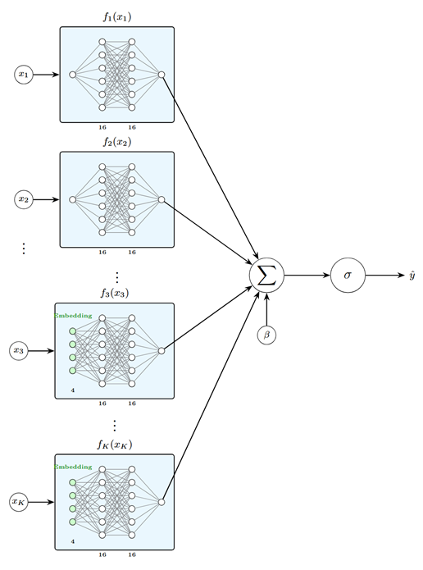
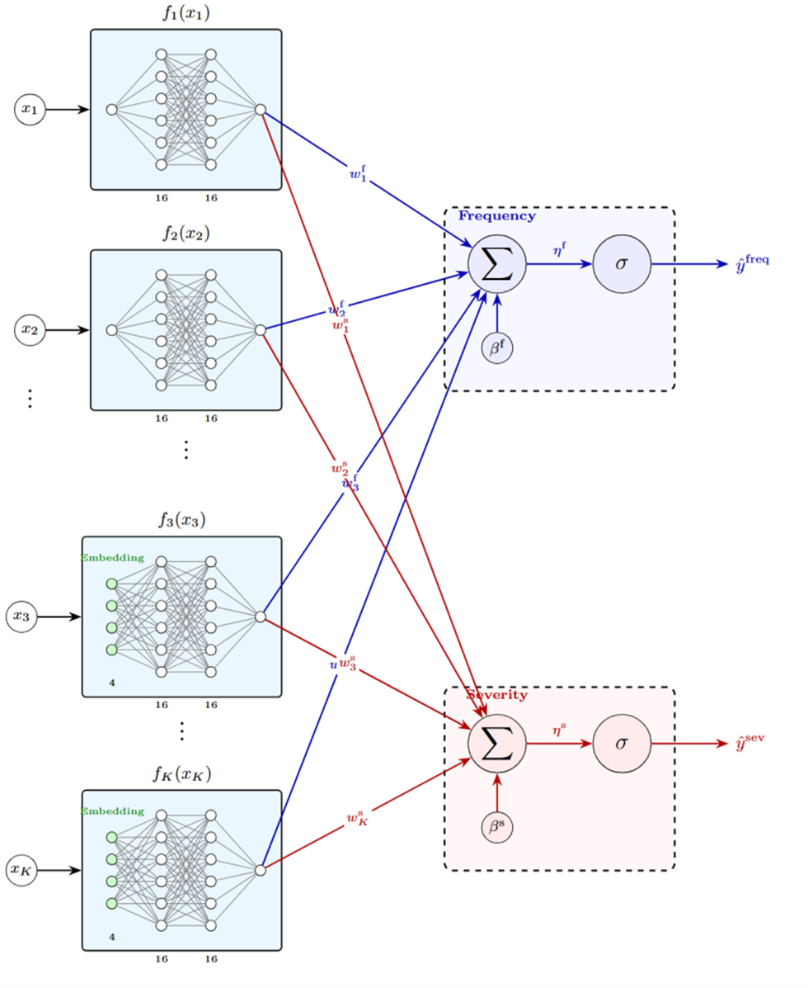
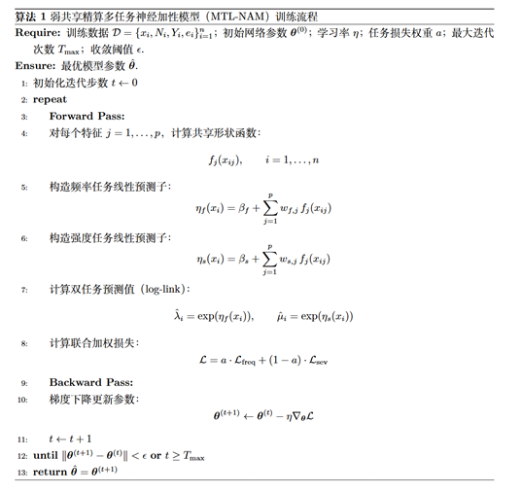
Model Architecture and Training
NAM (left) and MTL-NAM (right) architectures
MTL-NAM training pseudocode
Notes:
MTL-NAM can be understood in three layers. First, each input feature has its own feature subnetwork; categorical variables are first mapped to low-dimensional embeddings before entering their subnetworks. Second, the frequency and severity tasks share these feature subnetworks to learn common risk information, while task-specific weights and intercepts allow the same feature to have different magnitudes of effect across the two tasks. Third, log links produce positive frequency and severity predictions, which are multiplied according to the frequency–severity decomposition to obtain the policy-level pure premium prediction.

Slide 12

03
Experimental Results and Analysis
EXPERIMENTAL RESULTS AND ANALYSIS

Slide 13
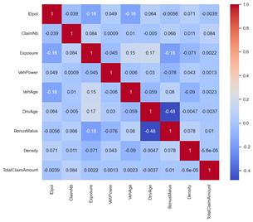


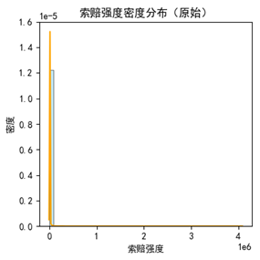
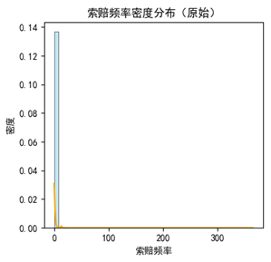


Exploratory Analysis: Distributions and Correlations
Distributional Characteristics
Claim frequency: strongly zero-inflated and heavy-tailed; most policies have no claims.
Claim severity: highly skewed and heavy-tailed, with large losses concentrated in a small number of observations.
Correlation Analysis
Key negative relationship: DrivAge and BonusMalus are strongly negatively correlated, consistent with business intuition.
Weak linear correlations: most predictors have low linear correlation with the responses, suggesting substantial nonlinear structure.
Notes:
I will now turn to the empirical results. Before modeling, I conducted exploratory data analysis. Both claim frequency and claim severity display strong skewness and heavy tails, while most predictors have weak linear correlations with the responses. These patterns provide motivation for using a nonlinear but interpretable model such as MTL-NAM.

Slide 14



Model Performance Comparison
💡 Key Finding
Under the reported evaluation framework, MTL-NAM achieves the best values across all listed metrics and outperforms GLM and single-task NAM while remaining competitive with GBM.
The frequency–severity evaluation provides supportive evidence for MTL-NAM in pure premium modeling.
 | NLL | RMSE | MAE
GLM | 0.243 | 2.018 | 0.190
GBM | 0.239 | 2.017 | 0.190
NAM | 0.156 | 2.018 | 0.189
MTL-NAM | 0.155 | 1.998 | 0.187
Best Reported Predictive Accuracy
NLL
RMSE
MAE
MTL-NAM records the lowest NLL, RMSE, and MAE in the reported frequency and severity comparisons.
Multi-Task Framework Adds Value
 | NLL | RMSE | MAE
GLM | 1.708 | 21387.021 | 2228.850
GBM | 2.759 | 21369.402 | 1708.529
NAM | 1.620 | 21320.620 | 2219.412
MTL-NAM | 1.605 | 21003.867 | 1634.039
Compared with single-task NAM, the multi-task framework improves performance by sharing information across related tasks.
Accuracy with Interpretability
The model retains inherent interpretability while achieving predictive performance competitive with a black-box GBM.
Test-set performance for claim frequency (top) and claim severity (bottom)
Notes:
The reported results show that, under the data and evaluation framework used in this study, MTL-NAM performs strongly on both the claim-frequency and claim-severity tasks. Relative to single-task NAM, the improvement is especially clear for severity. Embedding multi-task learning within an additive neural architecture therefore appears to improve predictive performance while preserving interpretability.

Slide 15
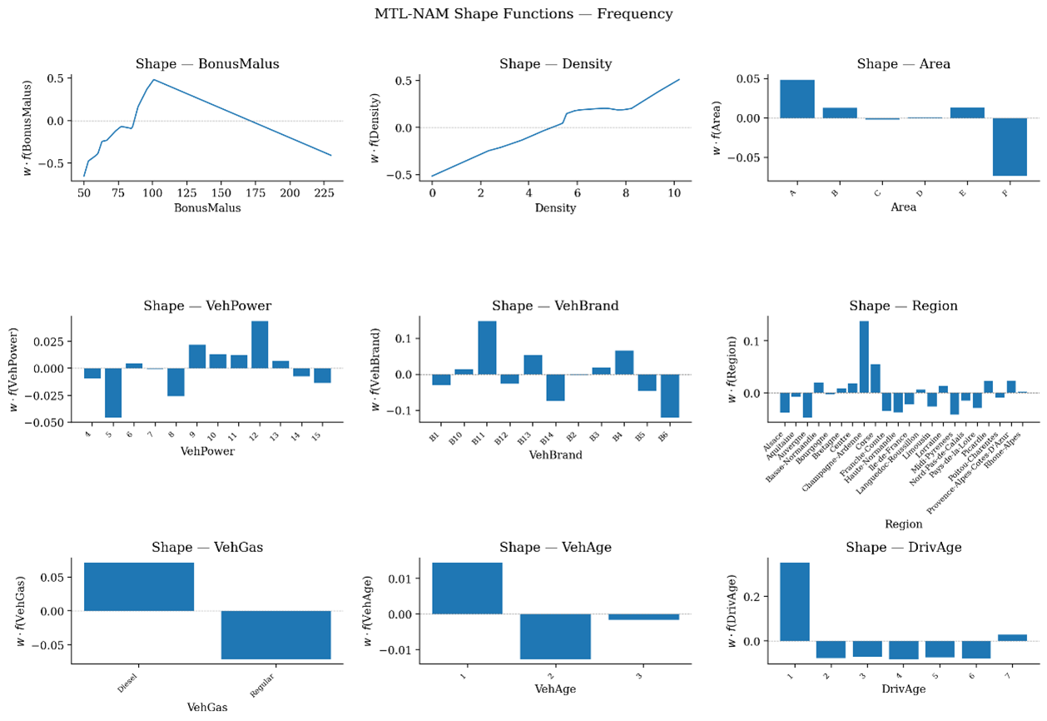

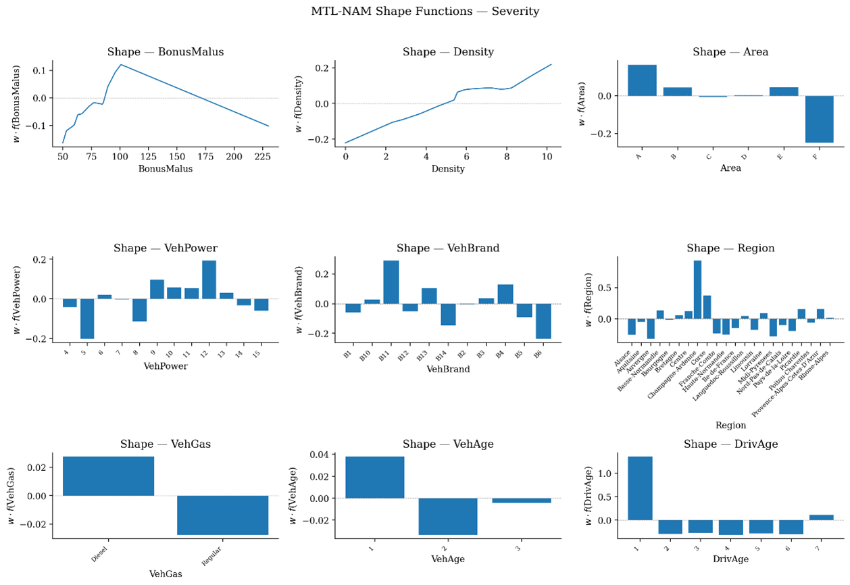


Interpretability: Shape Functions
Key Findings
MTL-NAM reveals nonlinear effects of risk factors on claim frequency and severity, with patterns broadly consistent with actuarial domain knowledge.
Heterogeneous Effects Across Frequency and Severity
Claim frequency: pronounced nonlinear and piecewise effects
Claim severity: different feature-effect mechanisms
MTL-NAM shape functions for claim frequency (top) and claim severity (bottom)
Notes:
Beyond predictive performance, the study also evaluates interpretability. Shape functions are an inherent interpretation mechanism of the model: they show the marginal effect of an individual feature on the prediction. The results indicate nonlinear and piecewise effects for several important risk factors in both the frequency and severity tasks.

Slide 16


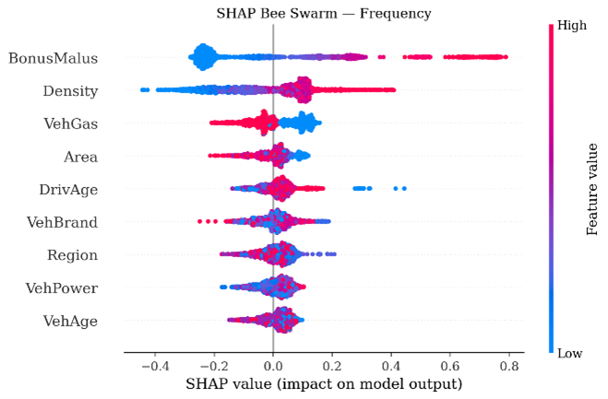
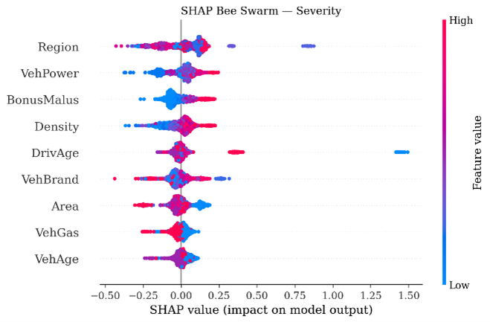

Interpretability: SHAP Feature Importance
Claim-Frequency Feature Importance
Claim-Severity Feature Importance
BonusMalus (experience-rating coefficient)
Region
Highest-ranked risk factor for claim-frequency prediction.
A major severity driver, potentially reflecting regional repair costs and price levels.
VehGas (fuel type)
VehPower (vehicle power)
Secondary factor reflecting differences in claim patterns across fuel types.
Higher-powered vehicles may be associated with higher repair costs and larger claim amounts.
Density (population density)
BonusMalus (experience-rating coefficient)
Key factor associated with differences in local traffic environments.
Related to driving experience and claim history, with different contribution patterns across policies.
Business Interpretation
The model identifies distinct drivers of claim frequency and severity, and the patterns are broadly consistent with actuarial business intuition.
Notes:
SHAP is used as a supplementary post-hoc explanation method to quantify each feature’s contribution at the observation level and across the portfolio. The importance rankings and effect pathways differ between the frequency and severity tasks, showing that MTL-NAM can preserve an interpretable structure while revealing task-specific heterogeneity in risk factors.

Slide 17

04
Conclusions, Limitations, and Future Work
CONCLUSION AND PROSPECT

Slide 18



Research Conclusions
Predictive Performance
Interpretability
Multi-Task Learning
Within this study’s evaluation framework, MTL-NAM performs strongly, outperforming GLM and single-task NAM and remaining competitive with GBM.
The additive architecture provides transparent, auditable feature effects; shape functions and SHAP help quantify and interpret risk-factor contributions.
Joint modeling of frequency and severity allows the model to exploit shared risk information and improves generalization across the cross-validation folds.
Notes:
The study leads to three main conclusions. First, under the data and evaluation framework used here, MTL-NAM is highly competitive for motor insurance pure premium modeling. Second, it retains the interpretable structure of a neural additive model, which is better aligned with transparency and auditability requirements in actuarial pricing. Third, multi-task learning is suitable for joint frequency–severity modeling because it can learn risk structure shared by the two tasks within a unified framework.

Slide 19



Contributions, Limitations, and Future Work
01
Core Contributions
02
Limitations
03
Future Work
Methodological Integration
No Explicit Feature Interactions
Model Extensions
Add interaction modeling and incorporate monotonicity, smoothness, and other business-informed constraints.
Integrates multi-task learning with neural additive models for motor insurance pure premium prediction.
The current model focuses on main effects and does not explicitly model higher-order feature interactions.
Broader Applications
Unified Modeling Framework
Limited Business Constraints
Explore applications in risk segmentation, fraud detection, and pricing across additional insurance lines.
Builds a unified framework for frequency and severity while implicitly learning shared risk structure.
No explicit monotonicity constraints are imposed, so some learned effects may deviate from actuarial priors.
Theoretical Development
Study the theoretical foundations of multi-task learning in actuarial science and identify more effective parameter-sharing structures.
Notes:
The main contribution is the integration of multi-task learning with a neural additive model in a frequency–severity pricing framework, evaluated from both predictive and interpretability perspectives. The study also has several limitations. The data come from a public French motor insurance dataset and may not transfer directly to the Chinese market; the model focuses primarily on main effects and does not explicitly represent higher-order interactions; and it does not impose strict monotonicity constraints or sparse regularization. Future work could incorporate proprietary business data, model feature interactions, add monotonicity constraints, and develop methods for translating the model into practical tariff structures.

Slide 20

THANKS
THANK YOU
Comments and suggestions are welcome
FOR LISTENING
Notes:
This concludes my presentation. Thank you very much for your time and attention. I welcome your comments and questions.

